Slide 1
DB
SELECT WHERE
IS NULL / IS NOT NULL
AND / OR
SUM / COUNT

Slide 2

OBJECTIVES FOR TODAY
SELECT WHERE statement
EQUAL/ NOT EQUAL / GREATER
IS NULL / NOT NULL
IN / NOT IN
ORDER BY
ASC
DESC
SUN / COUNT

Slide 3
SELECT COLUMNS
SELECT column1, column2 FROM table;
SELECT
THE COLUMNS
SELECT
THE TABLE
SELECT
FROM

Slide 4
SELECT COLUMNS
GO HERE
https://www.w3schools.com/sql/trysql.asp?filename=trysql_op_in
Display all columns
SELECT * FROM Customers;
Only the customer city and name
SELECT City, CustomerName FROM Customers;

Slide 5
FILTER ROWS
SELECT column1 FROM table WHERE city = “paris”;
SELECT
THE COLUMNS
SELECT
THE TABLE
FILTER
THE ROWS
SELECT
FROM
WHERE

Slide 6
FILTER ROWS
GO HERE
https://www.w3schools.com/sql/trysql.asp?filename=trysql_op_in
Display the name of customers from Mexico
SELECT * FROM customers WHERE city = “paris”;

Slide 7
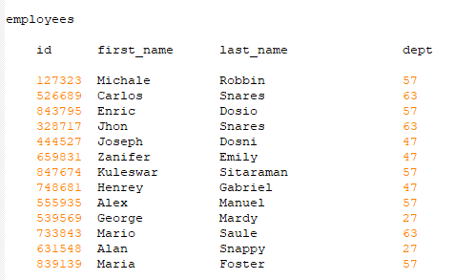
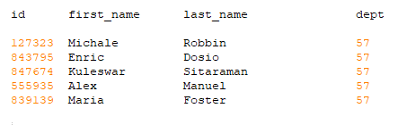
Display all the data of employees that work in the department 57
Database
Expected result
A
C
SELECT *
FROM employees
WHERE dept= 57;
SELECT *
OF employees
WHERE dept == 57;
B
D
SELECT *
OF employees
WHERE dept= 57;
SELECT *
WHERE dept = 57;

Slide 8
Display all the data of employees that work in the department 57
Database
Expected result
A
C
SELECT *
FROM employees
WHERE dept= 57;
SELECT *
OF employees
WHERE dept == 57;
B
D
SELECT *
OF employees
WHERE dept= 57;
SELECT *
WHERE dept = 57;

Slide 9

Find the first + last name of employees whose last name is Snares
Database
Expected result
SELECT *
FROM employees
WHERE last_name= 'Snares';
SELECT *
IN employees
WHERE last_name= 'Snares';
A
C
SELECT * OF first_name , last_name
FROM employees
WHERE last_name= 'Snares';
SELECT first_name , last_name
FROM employees
WHERE last_name= 'Snares';
B
D

Slide 10
Find the first + last name of employees whose last name is Snares
Database
Expected result
SELECT *
FROM employees
WHERE last_name= 'Snares';
SELECT *
IN employees
WHERE last_name= 'Snares';
A
C
SELECT * OF first_name , last_name
FROM employees
WHERE last_name= 'Snares';
SELECT first_name , last_name
FROM employees
WHERE last_name= 'Snares';
B
D

Slide 11

What to change in this query to display columns as expected ?
Expected result
SELECT first_name , last_name
FROM employees
WHERE last_name= 'Snares';
SELECT first_name
FROM employees
WHERE last_name= 'Snares‘
AS “FIRST”, “LAST”;
SELECT first_name
FROM employees
WHERE last_name= 'Snares‘
LIKE “FIRST”, “LAST”;
A
C
SELECT first_name AS “FIRST”, last_name AS “LAST”
FROM employees
WHERE last_name= 'Snares';
D
SELECT first_name LIKE “FIRST”, last_name LIKE “LAST”
FROM employees
WHERE last_name= 'Snares';
B

Slide 12
What to change in this query to display columns as expected ?
Expected result
SELECT first_name , last_name
FROM employees
WHERE last_name= 'Snares';
SELECT first_name
FROM employees
WHERE last_name= 'Snares‘
AS “FIRST”, “LAST”;
SELECT first_name
FROM employees
WHERE last_name= 'Snares‘
LIKE “FIRST”, “LAST”;
A
C
SELECT first_name AS “FIRST”, last_name AS “LAST”
FROM employees
WHERE last_name= 'Snares';
D
SELECT first_name LIKE “FIRST”, last_name LIKE “LAST”
FROM employees
WHERE last_name= 'Snares';
B

Slide 13

Display all the data of employees that work in department 63
but exclude employee whose last name is 'Snares'.
Database
Expected result
SELECT *
FROM employees
WHERE dept= 57
AND last_name != 'Snares';
SELECT *
FROM employees
WHERE dept= 57
AND last_name = 'Snares';
A
C
63
63
SELECT *
FROM employees
WHERE dept= 57
EXCLUDES last_name = 'Snares';
SELECT *
FROM employees
WHERE dept= 57
OR last_name != 'Snares';
B
D
63
63

Slide 14
Display all the data of employees that work in department 63
but exclude employee whose last name is 'Snares'.
Database
Expected result
SELECT *
FROM employees
WHERE dept= 57
AND last_name != 'Snares';
SELECT *
FROM employees
WHERE dept= 57
AND last_name = 'Snares';
A
C
63
63
SELECT *
FROM employees
WHERE dept= 57
EXCLUDES last_name = 'Snares';
SELECT *
FROM employees
WHERE dept= 57
OR last_name != 'Snares';
B
D
63
63

Slide 15
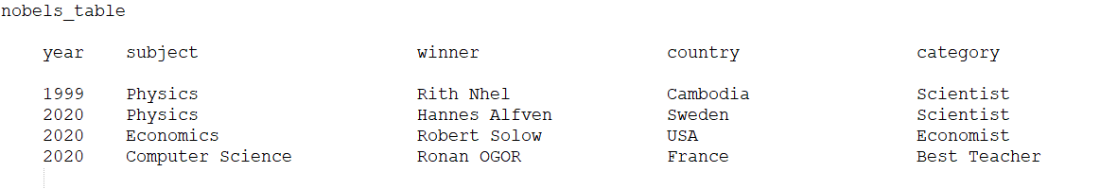
Put in order the below query
10 MIN - ACTIVITY
To get this result:
Winner
Ronan OGOR
NOT IN
WHERE
SELECT
year=2020
FROM
subject
AND
winner
('Physic','Economics')
nobels_table

Slide 16
ORDER ROWS
SELECT column1, column2 FROM table ORDER BY city ASC;
SELECT
THE COLUMNS
SELECT
THE TABLE
FILTER
THE ROWS
ORDER
THE ROWS
SELECT
FROM
WHERE
ORDERBY

Slide 17
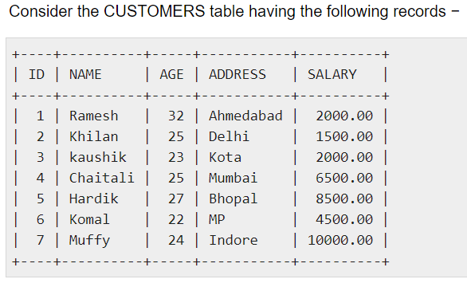
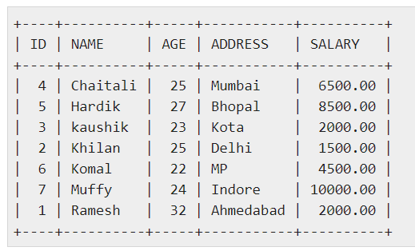
Customers
Expected result
A
SELECT *
FROM customers
ORDER BY name;
C
SELECT *
FROM customers
ORDER BY name or salary;
B
SELECT *
FROM customers
ORDER BY name, salary;
D
SELECT *
FROM customers
ORDER BY “name salary”;

Slide 18
Customers
Expected result
A
SELECT *
FROM customers
ORDER BY name ;
C
SELECT *
FROM customers
ORDER BY name or salary;
B
SELECT *
FROM customers
ORDER BY name, salary;
D
SELECT *
FROM customers
ORDER BY “name salary”;

Slide 19
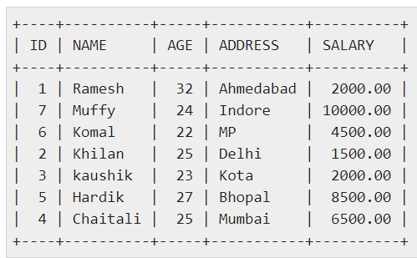
Customers
Expected result
A
SELECT *
FROM customers
ORDER BY name DESC;
C
SELECT *
FROM customers
ORDER BY name;
B
SELECT *
FROM customers
ORDER BY @name DESC;
D
SELECT *
FROM customers
ORDER BY “name DESC”;

Slide 20
Customers
Expected result
A
SELECT *
FROM customers
ORDER BY name DESC;
C
SELECT *
FROM customers
ORDER BY name;
B
SELECT *
FROM customers
ORDER BY @name;
D
SELECT *
FROM customers
ORDER BY “name”;

Slide 21
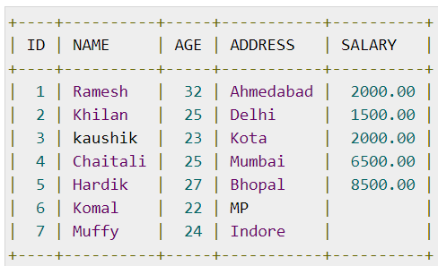
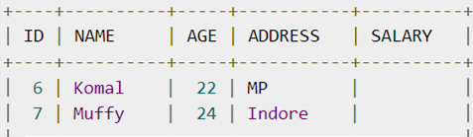
Customers
Expected Result
A
SELECT ID, name, address, salary
FROM customers
WHERE salary = NULL;
C
SELECT ID, name, address, salary
FROM customers
WHERE salary #NULL;
B
SELECT ID, name, address, salary
FROM customers
WHERE salary IS NULL;
D
SELECT ID, name, address, salary
FROM customers
WHERE salary @NOT NULL;

Slide 22
Customers
Expected Result
A
SELECT ID, name, address, salary
FROM customers
WHERE salary = NULL;
C
SELECT ID, name, address, salary
FROM customers
WHERE salary #NULL;
B
SELECT ID, name, address, salary
FROM customers
WHERE salary IS NULL;
D
SELECT ID, name, address, salary
FROM customers
WHERE salary @NOT NULL;

Slide 23
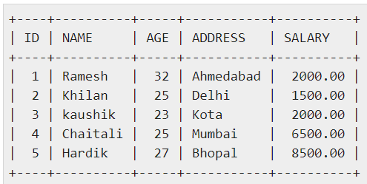
Customers
Expected Result
A
SELECT ID, name, address, salary
FROM customers
WHERE salary NOT NULL;
C
SELECT ID, name, address, salary
FROM customers
WHERE salary IS NOT NULL;
B
SELECT ID, name, address, salary
FROM customers
WHERE salary = NOT NULL;
D
SELECT ID, name, address, salary
FROM customers
WHERE salary @NOT NULL;

Slide 24
Customers
Expected Result
A
SELECT ID, name, address, salary
FROM customers
WHERE salary NOT NULL;
C
SELECT ID, name, address, salary
FROM customers
WHERE salary IS NOT NULL;
B
SELECT ID, name, address, salary
FROM customers
WHERE salary = NOT NULL;
D
SELECT ID, name, address, salary
FROM customers
WHERE salary @NOT NULL;

Slide 25
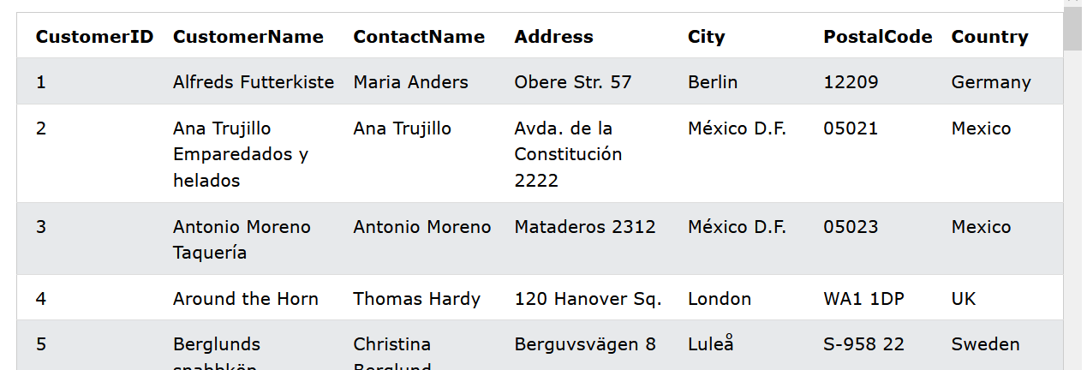
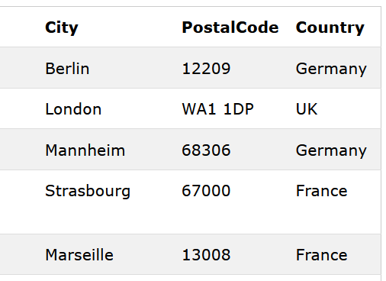
Customers
Expected Result
A
SELECT * FROM Customers
WHERE Country IN ('Germany', 'France', 'UK');
C
SELECT * FROM Customers
WHERE Country IN = ('Germany', 'France', 'UK');
B
SELECT * FROM Customers
WHERE Country IN 'Germany', 'France', 'UK';
D
SELECT * FROM Customers
WHERE Country IN@ ('Germany', 'France', 'UK');

Slide 26
Customers
Expected Result
A
SELECT * FROM Customers
WHERE Country IN ('Germany', 'France', 'UK');
C
SELECT * FROM Customers
WHERE Country IN = ('Germany', 'France', 'UK');
B
SELECT * FROM Customers
WHERE Country IN 'Germany', 'France', 'UK';
D
SELECT * FROM Customers
WHERE Country IN@ ('Germany', 'France', 'UK');

Slide 27
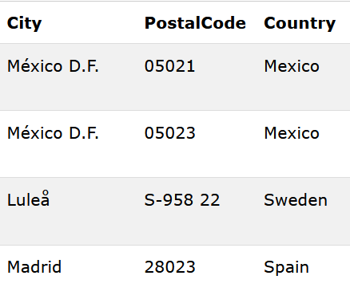
Customers
Expected Result
A
SELECT * FROM Customers
WHERE Country !=IN ('Germany', 'France', 'UK');
C
SELECT * FROM Customers
WHERE Country NOT IN ('Germany', 'France', 'UK');
B
SELECT * FROM Customers
WHERE Country NOT IN 'Germany', 'France', 'UK';
D
SELECT * FROM Customers
WHERE Country NOT IN@ ('Germany', 'France', 'UK');

Slide 28
Customers
Expected Result
A
SELECT * FROM Customers
WHERE Country !=IN ('Germany', 'France', 'UK');
C
SELECT * FROM Customers
WHERE Country NOT IN ('Germany', 'France', 'UK');
B
SELECT * FROM Customers
WHERE Country NOT IN 'Germany', 'France', 'UK';
D
SELECT * FROM Customers
WHERE Country NOT IN@ ('Germany', 'France', 'UK');

Slide 29
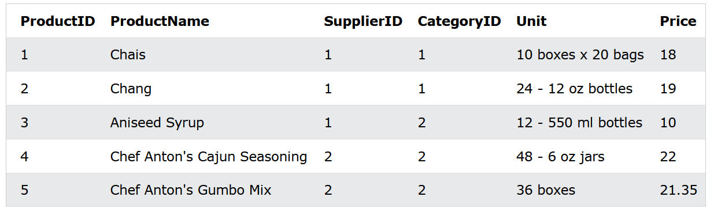
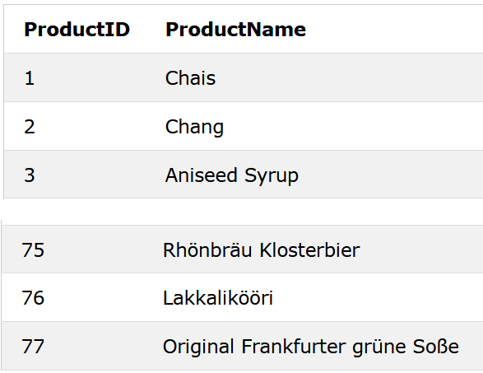
Products
Expected Result
77
A
SELECT COUNT@ProductID FROM Products;
C
SELECT COUNTS(ProductID) FROM Products;
B
SELECT COUNT ProductID FROM Products;
D
SELECT COUNT(ProductID) FROM Products;

Slide 30
Products
Expected Result
77
A
SELECT COUNT@ProductID FROM Products;
C
SELECT COUNTS(ProductID) FROM Products;
B
SELECT COUNT ProductID FROM Products;
D
SELECT COUNT(ProductID) FROM Products;

Slide 31
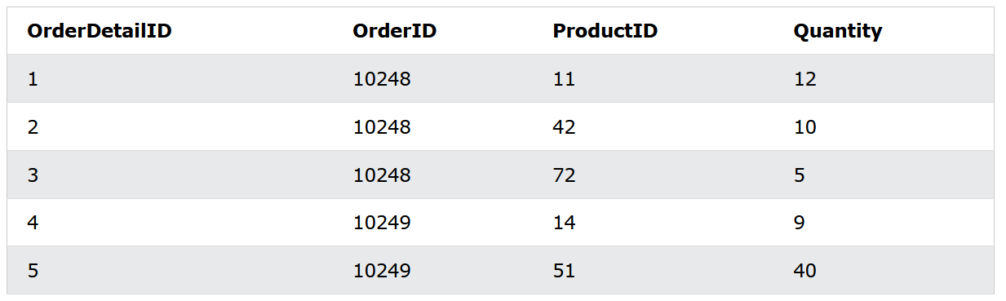
OrderDetails
Expected Result
12743
A
SELECT SUM(Quantity)
FROM OrderDetails;
C
SELECT SUMS(Quantity)
FROM OrderDetails;
B
SELECT SUM @Quantity
FROM OrderDetails;
D
SELECT SUM “Quantity”
FROM OrderDetails;

Slide 32
OrderDetails
Expected Result
12743
A
SELECT SUM(Quantity)
FROM OrderDetails;
C
SELECT SUMS(Quantity)
FROM OrderDetails;
B
SELECT SUM @Quantity
FROM OrderDetails;
D
SELECT SUM “Quantity”
FROM OrderDetails;

Slide 33
LET ‘S SUM UP !
SELECT
THE COLUMNS
SELECT
THE TABLE
ORDER
THE ROWS
SELECT
FROM
WHERE
ORDERBY
EQUAL
IS NULL/NOT NULL
ASC
DESC

Slide 34

HOMEWORK
C3-S1-THEORY - WHERE
BYBYE EVERYONE !! I’m IN THE PLANE !!!

